Slide 1
AI‑Driven Skill Intelligence and Learning Enablement System
Rishita Banerjee, XIMB
Chrysalis 2026

Slide 2
Agenda
01
Project Context & Objectives
02
AI Agent Development & Intelligence Layer
03
Visualization via Demo
04
Scalability & Future Scope

Slide 3
Project Context & Objectives
01

Slide 4
The Readiness Problem Behind L&D Outcomes
Problem Statement
Mismatch between skills developed through L&D and skills expected in delivery/client contexts.This creates readiness uncertainty and makes learning investments less targeted.
Skill Readiness Gaps
1
Readiness gaps fall into three layers:
Domain / Context — Sector and business Understanding
Technical Foundation — BI/SQL/data Fundamentals
Delivery / Client‑Facing — Workshops, Communication, Program Management
3
2
Business Impact
Delivery risk increases when readiness is unclear
Time‑to‑readiness rises due to rework and reactive upskilling
Client confidence drops despite “training completion”

Slide 5
Why Is Skill Readiness Intelligence Critical?
Industry Insights into the Market Scenario
41%
08%
26pp
Workforce Lacks Required Skills
Organizations Have Reliable Skill Data
Performance Drop Without Readiness
Skill gaps are operational blockers today
Data exists but isn’t decision‑ready
Readiness impacts execution directly
Gartner HR Research, 2024
Gartner HR Research, 2024
Gartner HR Research, 2024
41%
Have Adopted Skills‑Based Processes
+15pp
49%
Ahead In GenAI Adoption
Say AI Is Ahead Of Training
Most L&D lacks operational capability
AI success depends on skill readiness
Static learning models can’t keep up
Gartner, Skills‑Based Talent Mgmt, 2024
LinkedIn Workplace Learning Report, 2025
TalentLMS L&D Benchmark, 2024

Slide 6
Signal Index from Recurring Interview Themes
Anonymous insights derived from the current People Analytics skill inventory and stakeholder inputs
100%
75%
62%
38%
Delivery
Readiness Needs
Domain & Sector Context
Emerging Skills Demand
Learning
Adoption Risk
Client-facing confidence and delivery execution are recurring pain points
Domain/industry understanding drives client trust in delivery
GenAI & Cloud/Platform skills cited as rising expectations
Stagnation and inability to keep pace surfaced as a lower-frequency but real risk
Manager View of Skills and Readiness/Risk intelligence
Role & Sector-Aligned Readiness Visibility for Employees & Managers
Targeted Learning Journeys & Certification Readiness for Employees
Frequent Check Ins and Quick Quizzes

Slide 7
AI Agent Development & Intelligence Layer
02

Slide 8
AI Agent Build Flow: From Data to UI Experience
Explainable readiness logic operationalized through a lightweight UI and orchestration layer
Discovery
Data Layer
Readiness
UI Build
Integration
Interview themes captured
Delivery needs clarified
Readiness gap types framed
Mock dataset structured
Roles & skills mapped
Confidence/context fields added
Skill gap computed
Learning trigger defined
Normalized readiness score
Chat & Prompt chips for user
Dashboard view built
Manager view framework
Agentic AI orchestration flow
Data retrieval and routing
Readiness tracking dashboards
Phase 1
Phase 2
Phase 3
Phase 4
Phase 5

Slide 9
Launching Ascendra : the L&D Intelligence Platform
Learning Progress Aligned
Ascendra converts identified skill gaps into prioritized learning journeys (what to start/continue/complete) and provides ongoing progress visibility through streaks, completions, learning debt, and time-based tracking.
Personalized L&D Dashboard
Certification Readiness & Eligibility
Ascendra’s dashboard gives a single, actionable view of role readiness and skill gaps, tracks learning impact and momentum (including certification eligibility), and highlights priority focus areas through a skill-readiness matrix and gap severity indicators.
Ascendra provides readiness‑based certification guidance by mapping certifications to current skill readiness, highlighting gaps with targeted preparation paths, and guiding users to take the right next step at the right time—avoiding premature attempts.
Progress Tracking
Conversational AI
Guided Prompts
Readiness
Panel
Manager Dashboard
Ascendra provides on‑demand conversational L&D support that answers questions in natural language, offers guided prompts, and maintains session history/context to deliver consistent, personalized follow‑up guidance.
Ascendra converts identified skill gaps into prioritized learning journeys (what to start/continue/complete) and provides ongoing progress visibility through streaks, completions, learning debt, and time-based tracking.
L&D
Support
Manager View
Achievements
Platform Overview
Ascendra converts identified skill gaps into prioritized learning journeys (what to start/continue/complete) and provides ongoing progress visibility through streaks, completions, learning debt, and time-based tracking.
AI‑enabled L&D intelligence platform designed to provide continuous visibility into employee skill readiness.
Log-In
Ascendra Core
Gamification

Slide 10
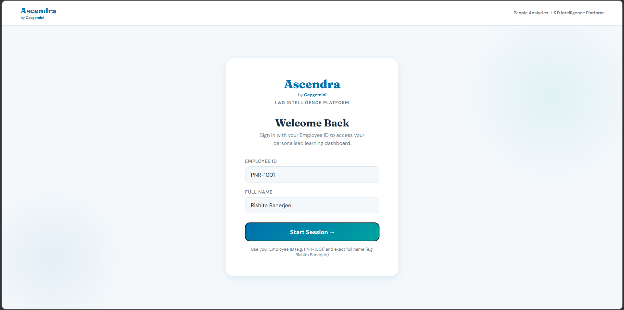

Slide 11
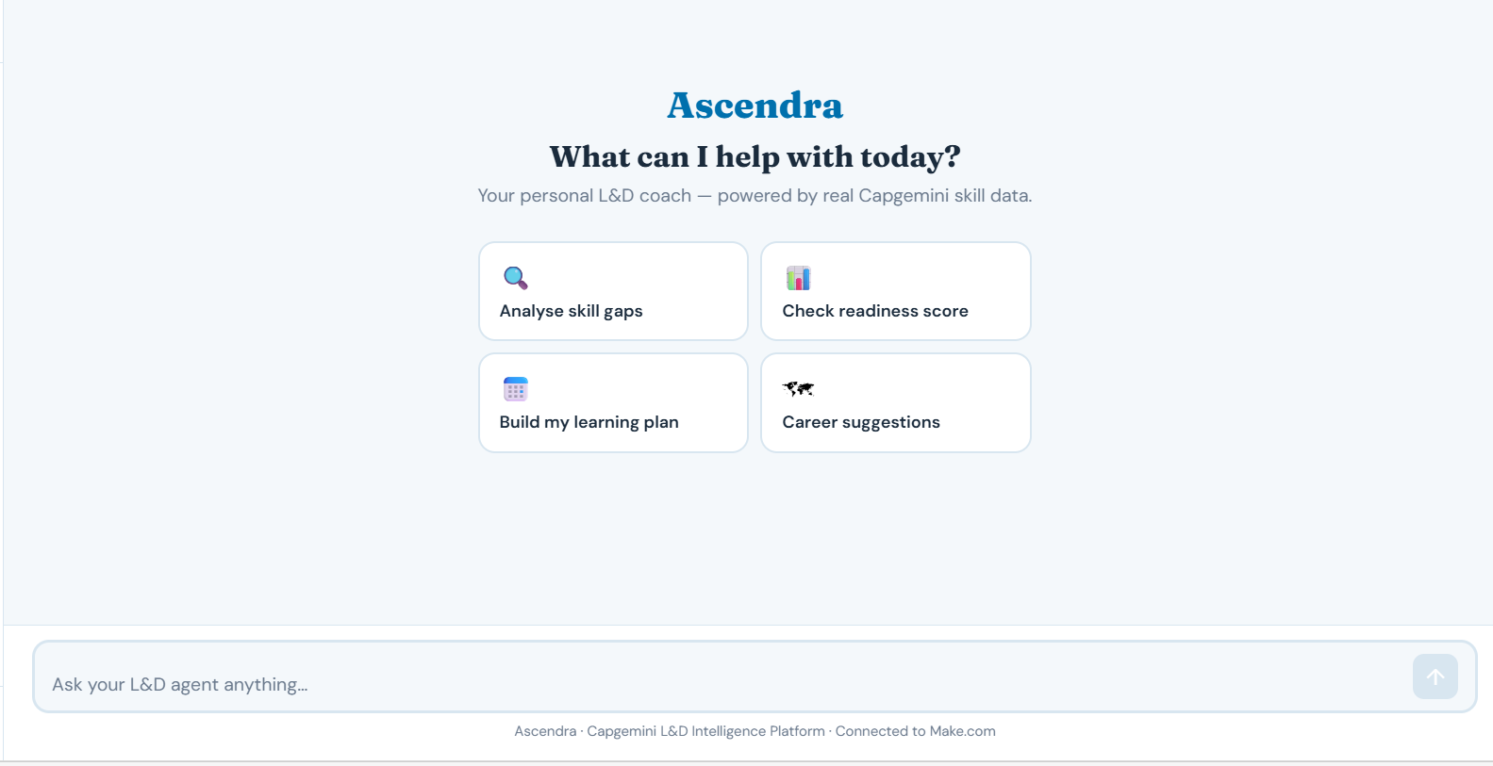
Always‑available, contextual guidance for learning and readiness
Guided Interactions with existing prompts
Ask any personalized questions to the AI Bot

Slide 12
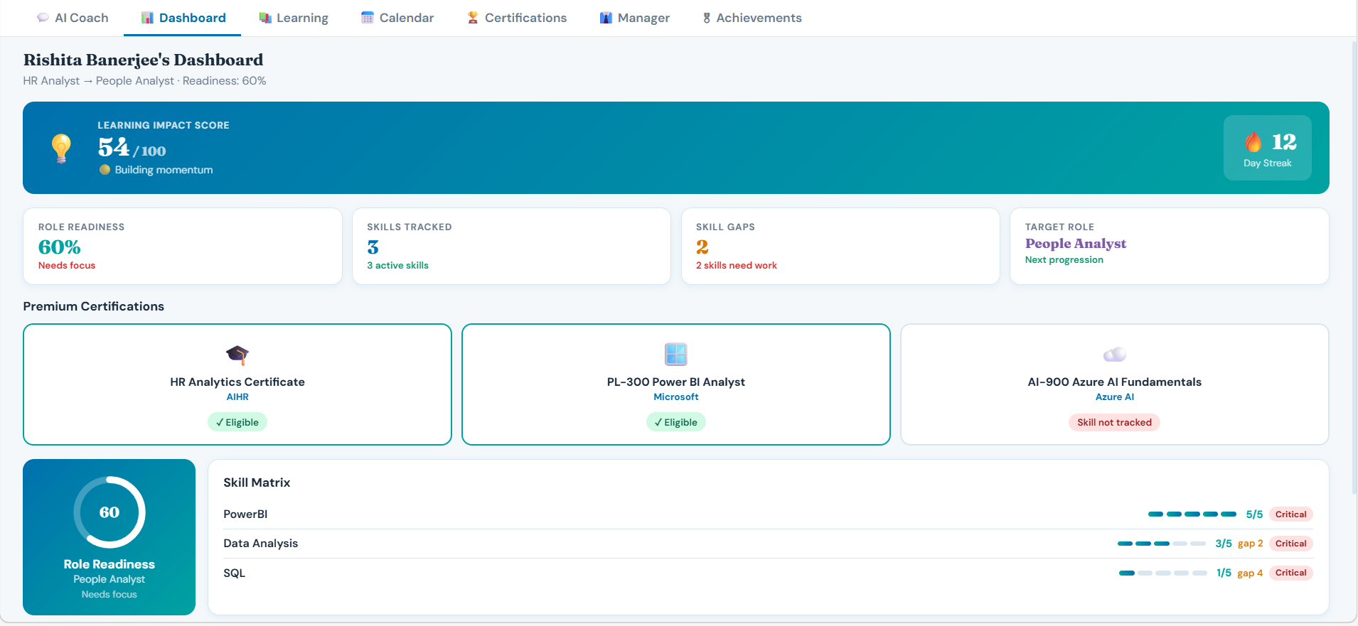

Slide 13
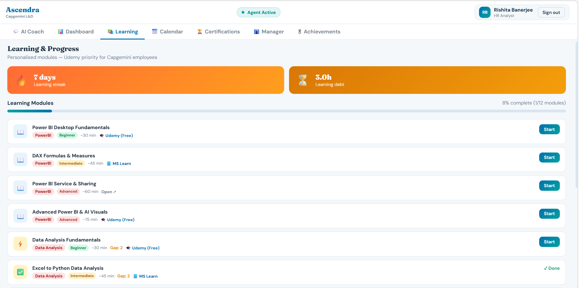

Slide 14
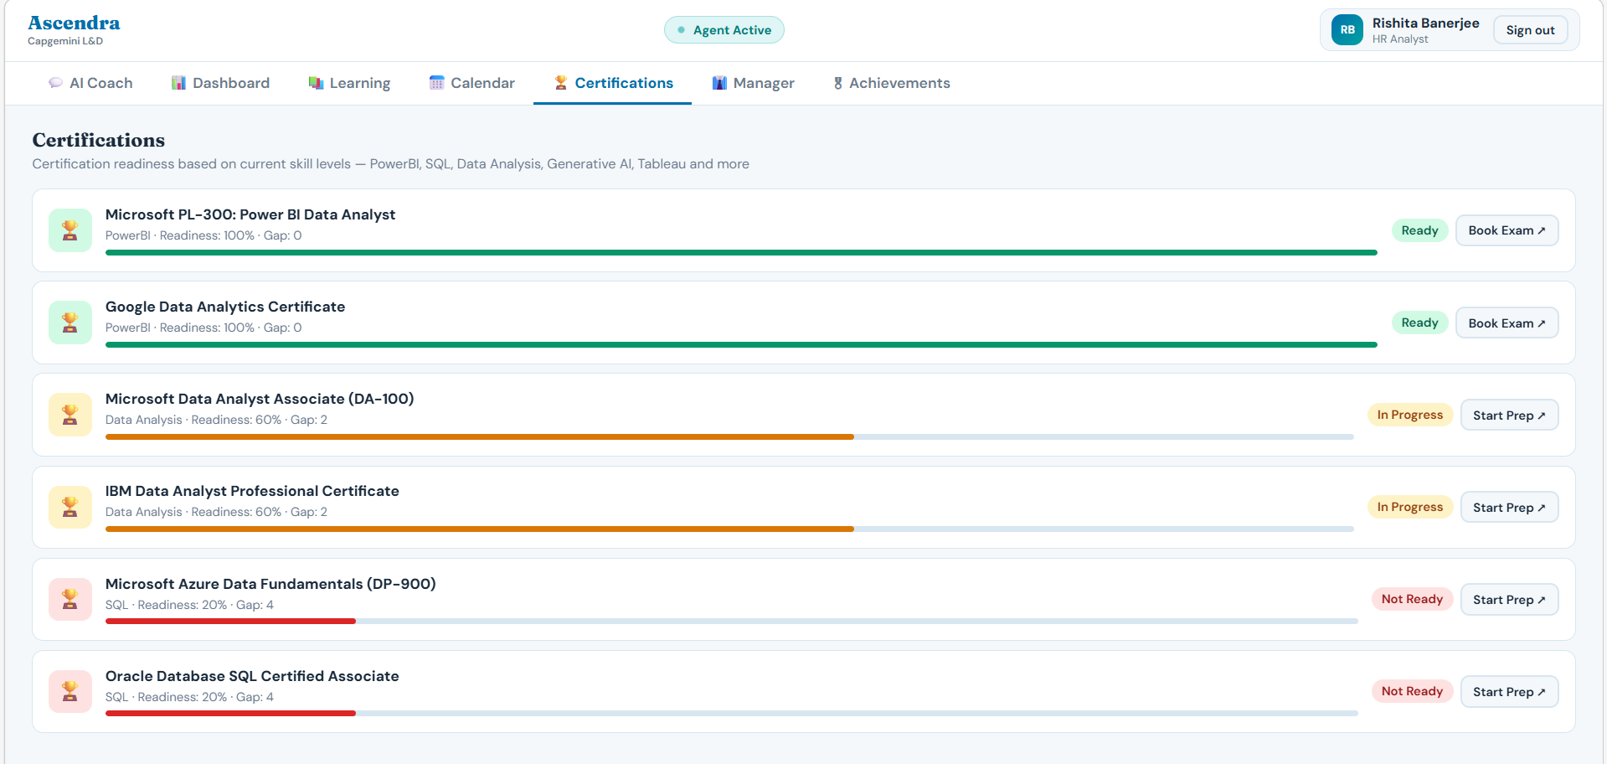

Slide 15
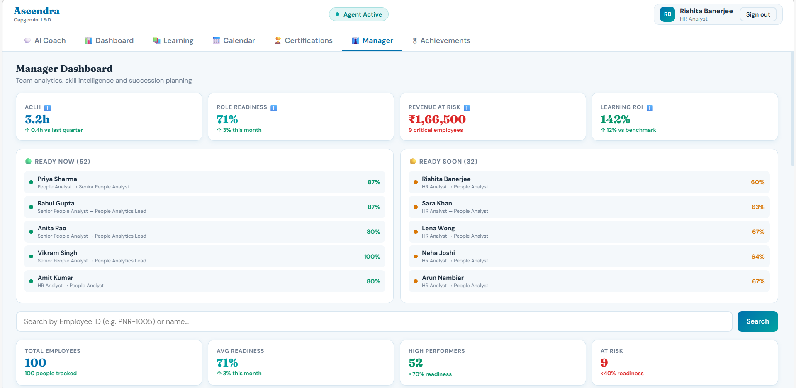

Slide 16
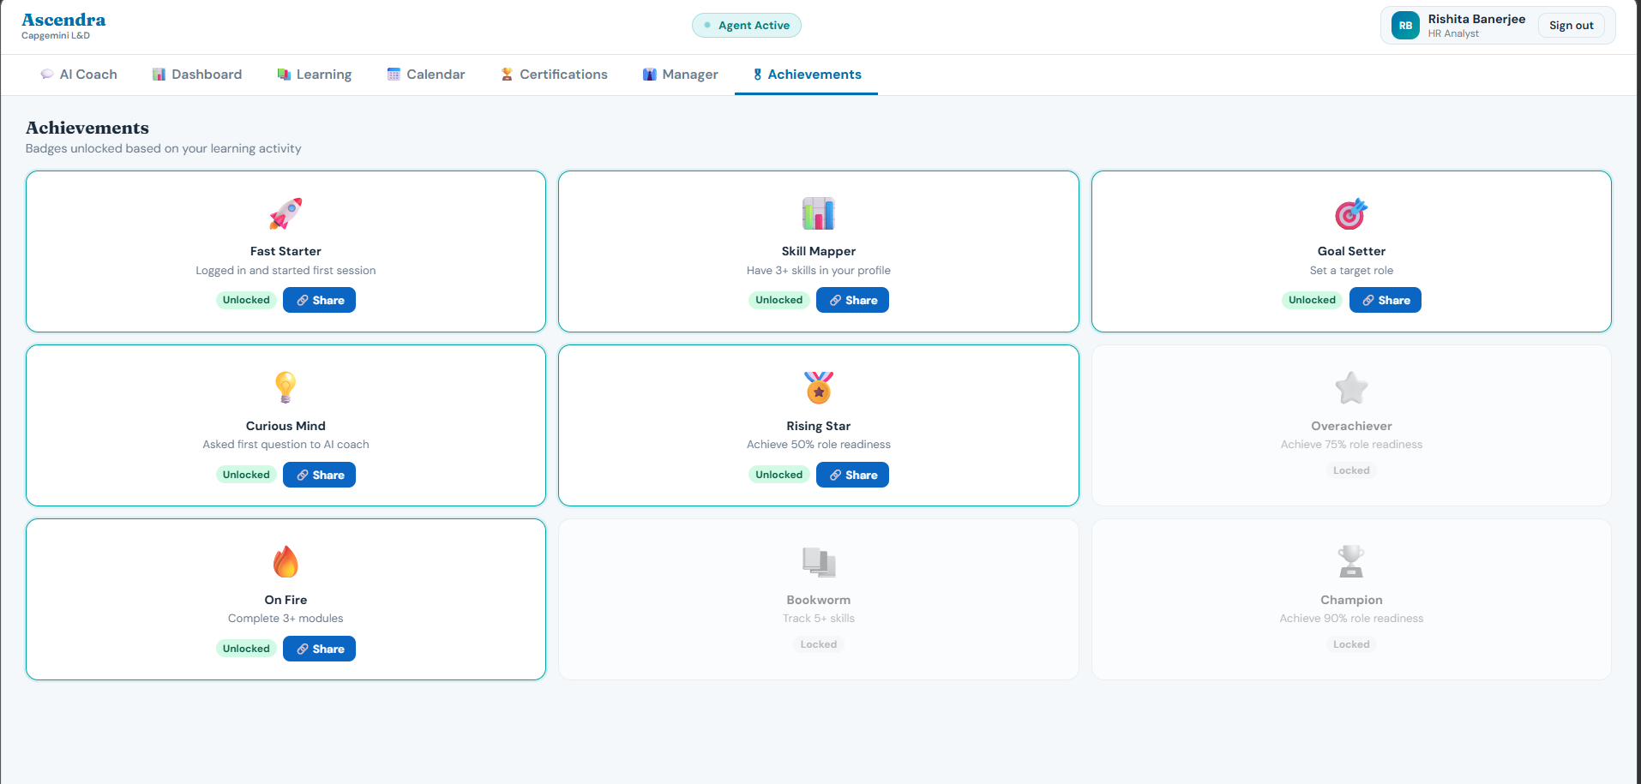

Slide 17
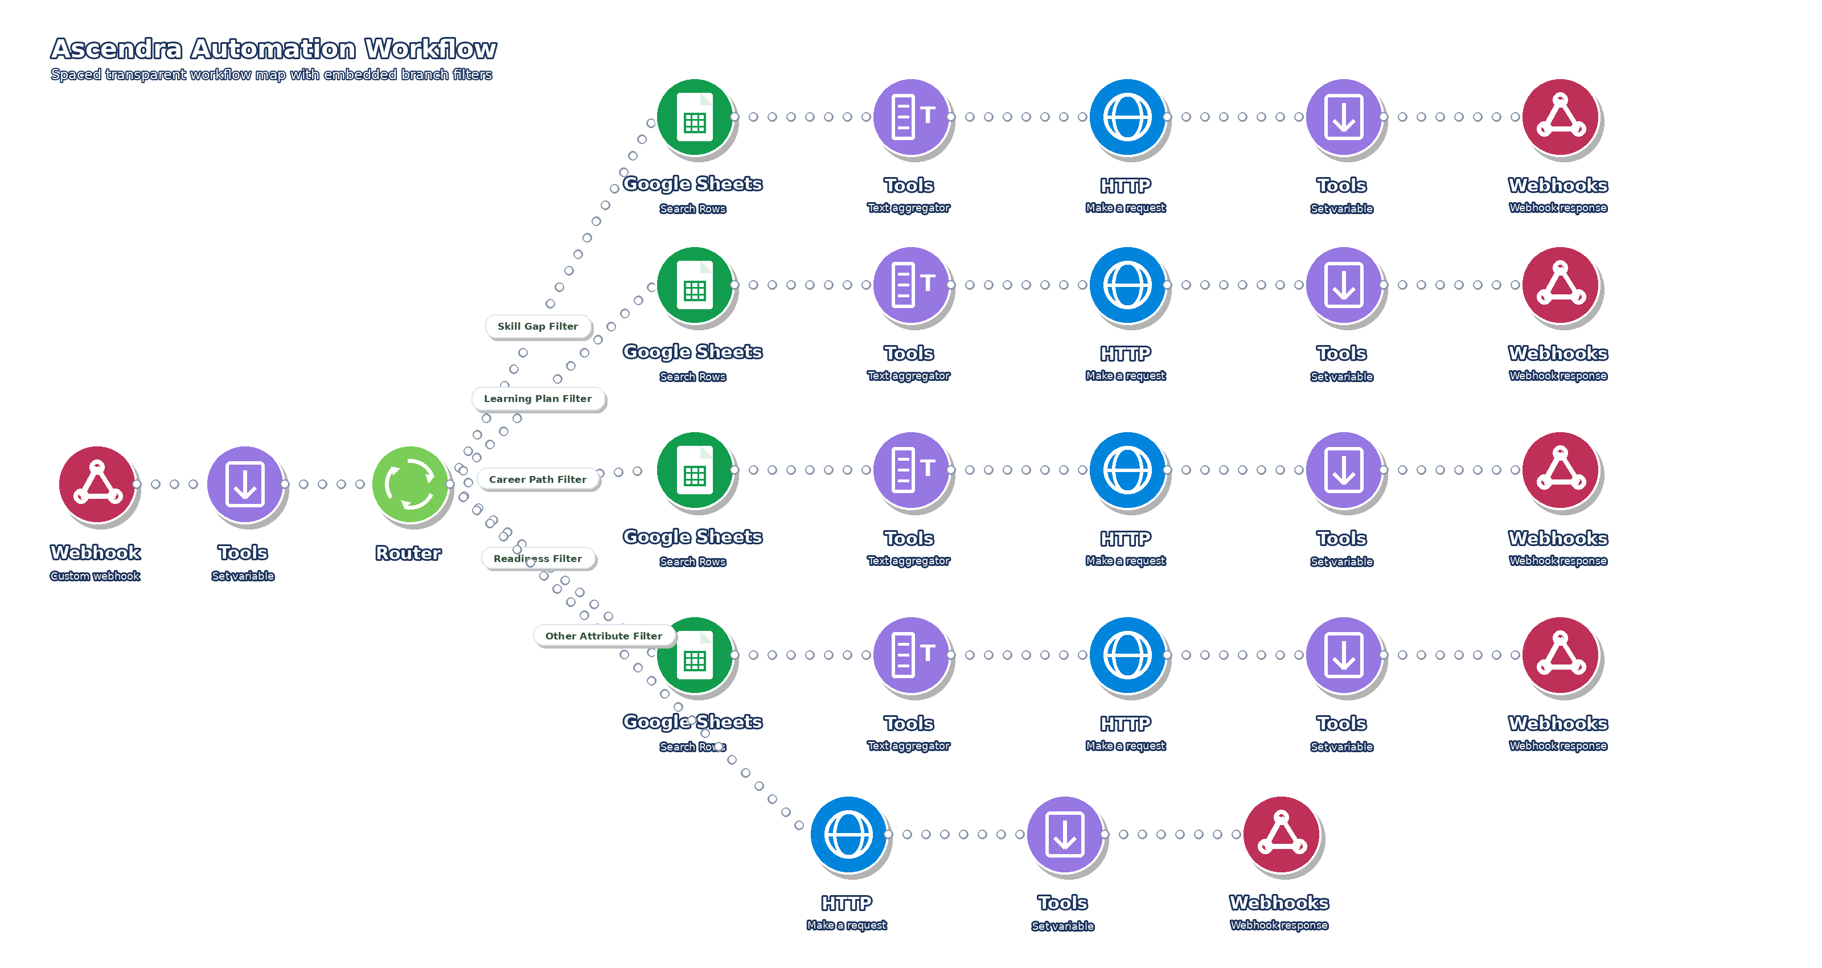
Agentic AI Backend & Orchestration Flow
Automated orchestration of data, intelligence, and user responses

Slide 18






Tools Powering Ascendra
How data, orchestration, and GenAI work together
02
03
01
04
Data Layer
GenAI Reasoning
Workflow
Engine
Interface
Structured mock skill dataset
Roles, skills & proficiency levels
Readiness & gap logic
ChatGPT, Claude, Copilot
Gap explanation & guidance
Learning recommendations
Make.com automation
Intent routing & logic flow
Groq LLM for api key integration
Ascendra HTML UI
Chat and dashboards guide
Manager view

Slide 19
Prompt Engineering in Ascendra
How user questions are structured into consistent, explainable AI responses
USER INPUT
PROCESSING
AI OUTPUT
“What should I learn next?”
Intent classification
Context injection
Response structure enforced
Actionable next steps from data
HOW THE PROMPT ACTUALLY WORKS IN THE BACKEND
Context
Understanding
Of the user’s Question
Data Mapping with keywords from Google Sheets
Structured Response with formatting Structure
Role Assumption Of the AI as an L&D Specialist

Slide 20
Visualization Demo
03

Slide 21
Ascendra – Capgemini L&D Intelligence Platform
People Analyst Excel Datasheet.xlsx
Backend of the AI Platform

Slide 22
Scalability & Future Scope
04

Slide 23
Ascendra in Action: Real L&D Use Case Scenario
Ascendra sub‑module enabling upskilling, interview readiness, and role understanding
01
02
03
04
Interview
Ready
Know Your Role
AI in Your Role
Upskilling
Curated learning paths based on your skill gaps.
Prioritized “what to learn next” by role readiness.
Track learning momentum and focus areas.
Role‑based question bank (technical & situational).
Practice sets with instant feedback and improvement tips.
Exportable report of strengths and focus areas.
Role overview: responsibilities, expectations, and skills.
Key terms, tools, and competency levels explained.
Clear roadmap to move to the next role.
Practical GenAI use‑cases mapped to your role.
Prompt templates and best practices for daily work.
Guidance on safe, responsible usage and productivity.
Click Here for Demo of the Internal Tool

Slide 24
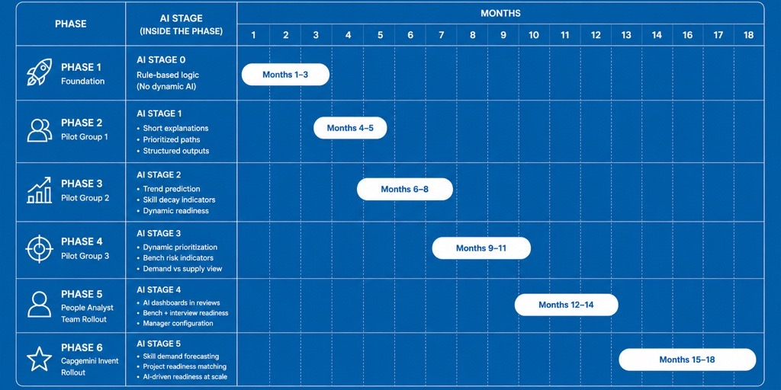
Implementation Plan for Ascendra
Ascendra sub‑module enabling upskilling, interview readiness, and role understanding

Slide 25
What Comes Next for Ascendra?
Enhancing intelligence, learning experience, and readiness outcomes over time
AI Customisation
Role‑specific guidance
Domain & industry awareness
Smarter response guardrails
Skill Validation & Feedback
Quizzes & micro‑assessments
Readiness recalibration
Evidence‑based feedback system
Integrated Learning Experience
Embedded video learning
Skill appointment by Managers
Time‑based learning plans
Proactive Intelligence
Readiness nudges
Learning debt alerts
Adaptive learning paths
Presentation Title | Author | Date
Company Confidential © Capgemini 2026. All rights reserved.
25

Slide 26
Impact slides
These slide designs and messages are inspirational only. Please modify text boxes and positioning as needed based on the message and overall composition. Always consider the legibility and contrast of copy and content for maximum usability.
Any and all photography in these designs is given as an example. While you can use them, it’s better to change the photography to match your content.
To do so, right click on the picture or placeholder to change/insert a photo.
Where to find photography:
Photo library
Getty images (Recommended), Shutterstock, Adobe images (check with your M&C design team):
Further examples and inspiration are available in Extras file in your Powerpoint -> File -> New from template…
Thank you.
Make it real.

